Slide 1
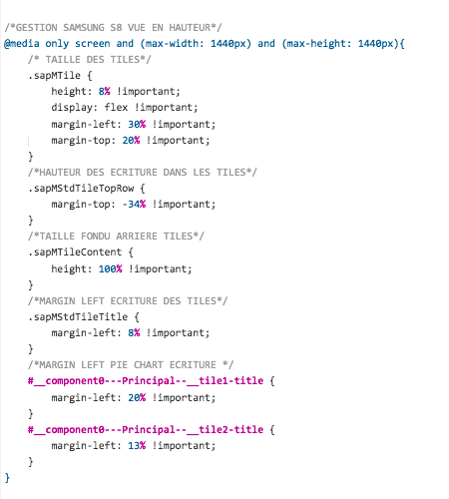
CSS - Media Queries

